Slide 1
AI-BASED LEARNER STREAM
RECOMMENDATION SYSTEM
Helping Grade 9 learners explore possible Grade 10 streams using marks, interests and career goals.
Student number | Initials | Surname
224917110 | BO | Sebati
240192338 | JH | Mdaka
223822094 | NBS | Duma
240303598 | R | Ramodise
240996666 | MC | Ratsaka
224384481 | TD | Mathiba

Slide 2
INTRODUCTION
AI STREAM RECOMMENDATIO SYSTE
In South Africa, Grade 9 learners are required to choose subjects when progressing to Grade 10. These choices are important because they can influence the courses learners qualify for at university or college and the careers they may pursue in the future.
However, making these decisions is not always easy. Learners need to understand their academic strengths, personal interests and future career goals before selecting their subjects. This is the background and motivation behind our project.
.

Slide 3
BUSINESS ANALYSIS 3.2 | AIBUY3A
THE PROBLEM OF OUR SOLUTION
THE CHALLENGE
WHY IT MATTERS
• Some Grade 9 learners choose their streams based on pressure or influence from parents, friends, and others instead of considering their academic strengths and personal interests.
• Some learners select subjects that do not match their academic strengths.
• Learners may have limited access to personalised guidance.
• Many learners lack career guidance and do not understand how subject choices relate to future careers, further studies, and job opportunities..
• It can be difficult to compare available academic options.
• Learners may find it challenging to make informed decisions about their futures.
• Additional accessible guidance can help learners explore their options.

Slide 4
BUSINESS ANALYSIS 3.2 | AIBUY3A
PROPOSED AI SOLUTION
A WEB-BASED RECOMMENDATION SYSTEM
• Our proposed solution is to develop an AI-powered website that provides personalised stream recommendations to Grade 9 learners.
• Instead of relying only on marks, the system will also consider the learner's interests, favourite subjects and future career goals.
• It will use machine learning to analyse academic performance and a chatbot powered by Natural Language Processing to understand the learner's written responses.
• By combining these two sources of information, the system will recommend a suitable academic stream, explain why it was selected and suggest possible career options.
• Our aim is to help learners make more informed decisions rather than making choices based only on the influence of other people.

Slide 5
BUSINESS ANALYSIS 3.2 | AIBUY3A
PROJECT OBJECTIVES
OBJECTIVES
OBJECTIVES (CONTINUED)
• Prepare process a dataset containing relevant learner information ,marks and recommended stream labels.
• Develop and evaluate a machine learning model that analyses Grade 9 academic performance for suitable stream recommendation.
• Develop a Random Forest model and compare its performance with the Decision Tree.
• Evaluate models using accuracy, precision, recall, and other appropriate methods.
• Develop an NLP chatbot to understand learners' interests and career aspirations.
• Build a website that collects learner information and displays recommendations.
• Integrate the machine learning model and chatbot into a website.
• Test functionality, usability and reliability; identify limitations and improvements.
• Use GitHub to manage files and monitor progress.
• Prepare the final documentation, presentation and project poster.
AI-BASED LEARNER STREAM RECOMMENDATION SYSTEM

Slide 6
BUSINESS ANALYSIS 3.2 | AIBUY3A
How the AI System Works
This system works in three main stages input, AI processing and output
First Stage : INPUT
Second Stage : AI PROCESSING
Final stage : OUTPUT
• The learner provides their Grade 9 marks and answers questions about their favourite subjects, interests, career goals and learning preferences
.
This is where the two main AI components perform different tasks.
Machine learning uses algorithms such as Decision Tree and Random Forest to analyse the learner's academic performance and identify suitable streams
• After the system combines the findings from both components The learner receives a recommended stream , an explanation of the recommendation and possible career options.
Natural Language Processing, also known as NLP, is used by the chatbot to understand the learner's written responses and identify their interests and career aspirations.
AI-BASED LEARNER STREAM RECOMMENDATION SYSTEM

Slide 7
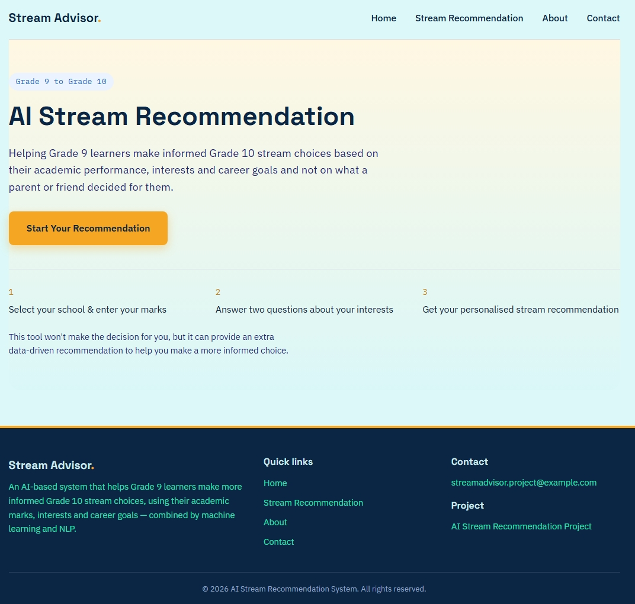
Website Structure and User Journey
HOME PAGE

Slide 8
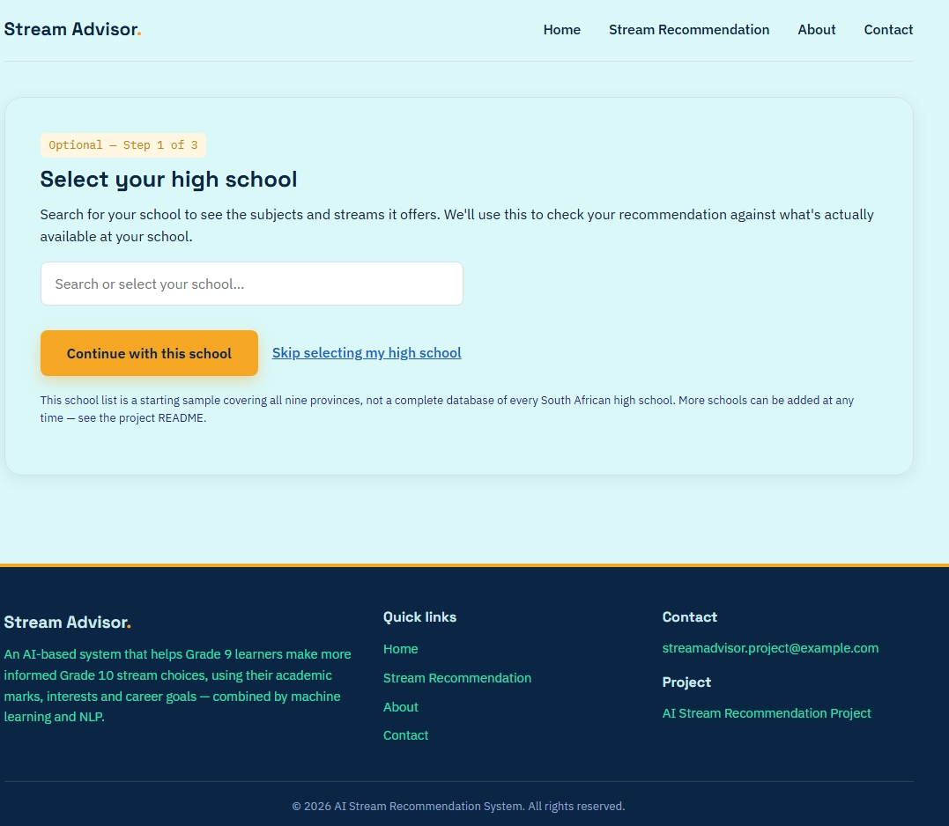
BUSINESS ANALYSIS 3.2 | AIBUY3A
Website Structure and User Journey (ConTINUED…)
SELECTING HIGH SCHOOL
AI-BASED LEARNER STREAM RECOMMENDATION SYSTEM

Slide 9
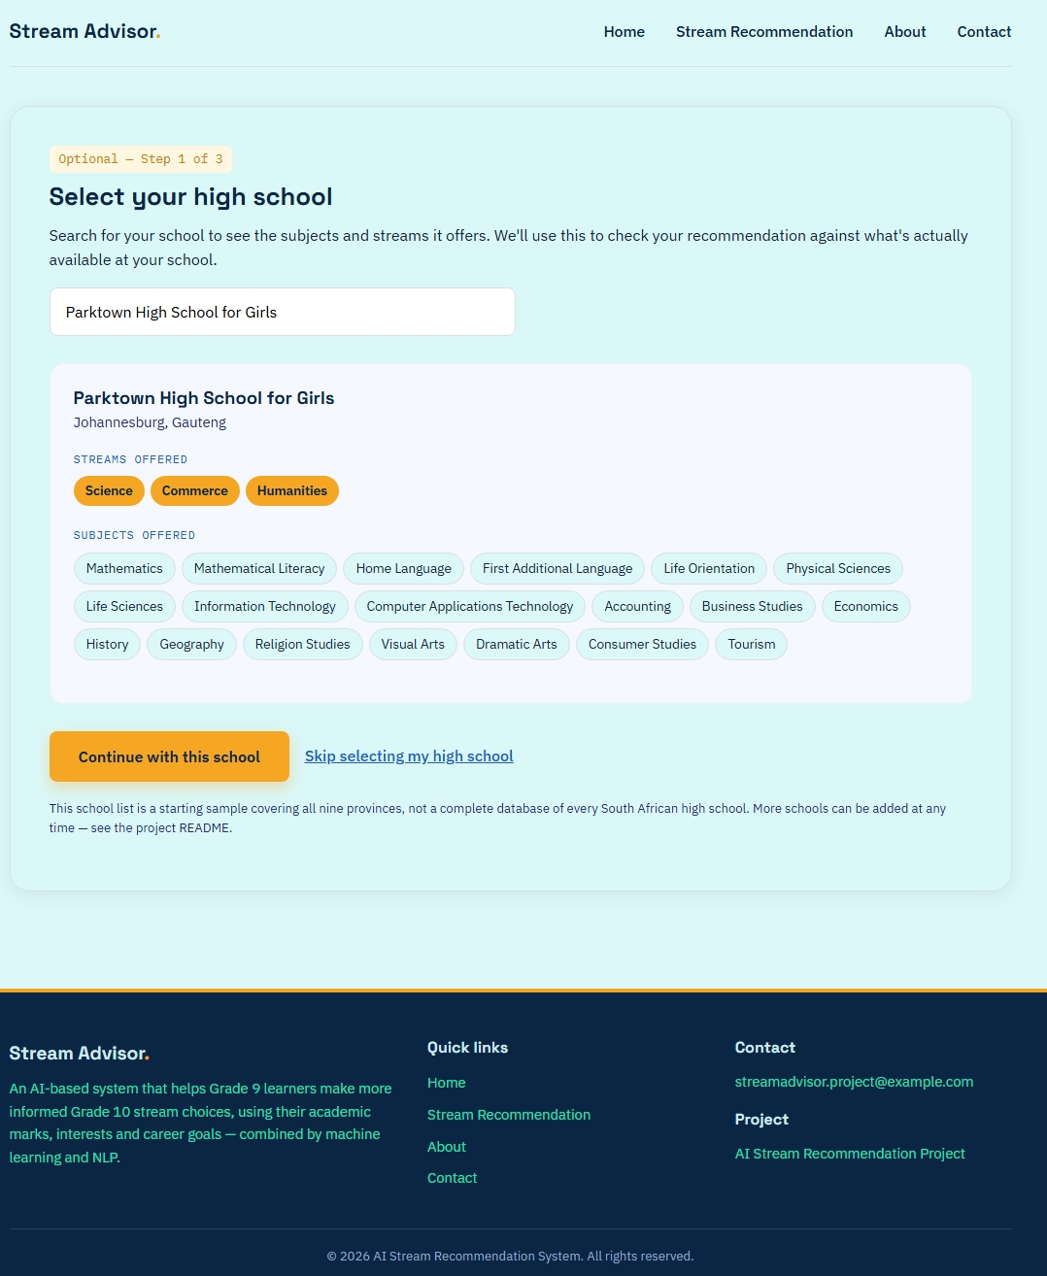
BUSINESS ANALYSIS 3.2 | AIBUY3A
Website Structure and User Journey (ConTINUED…)
SELECTED HIGH SCHOOL STREAMS

Slide 10
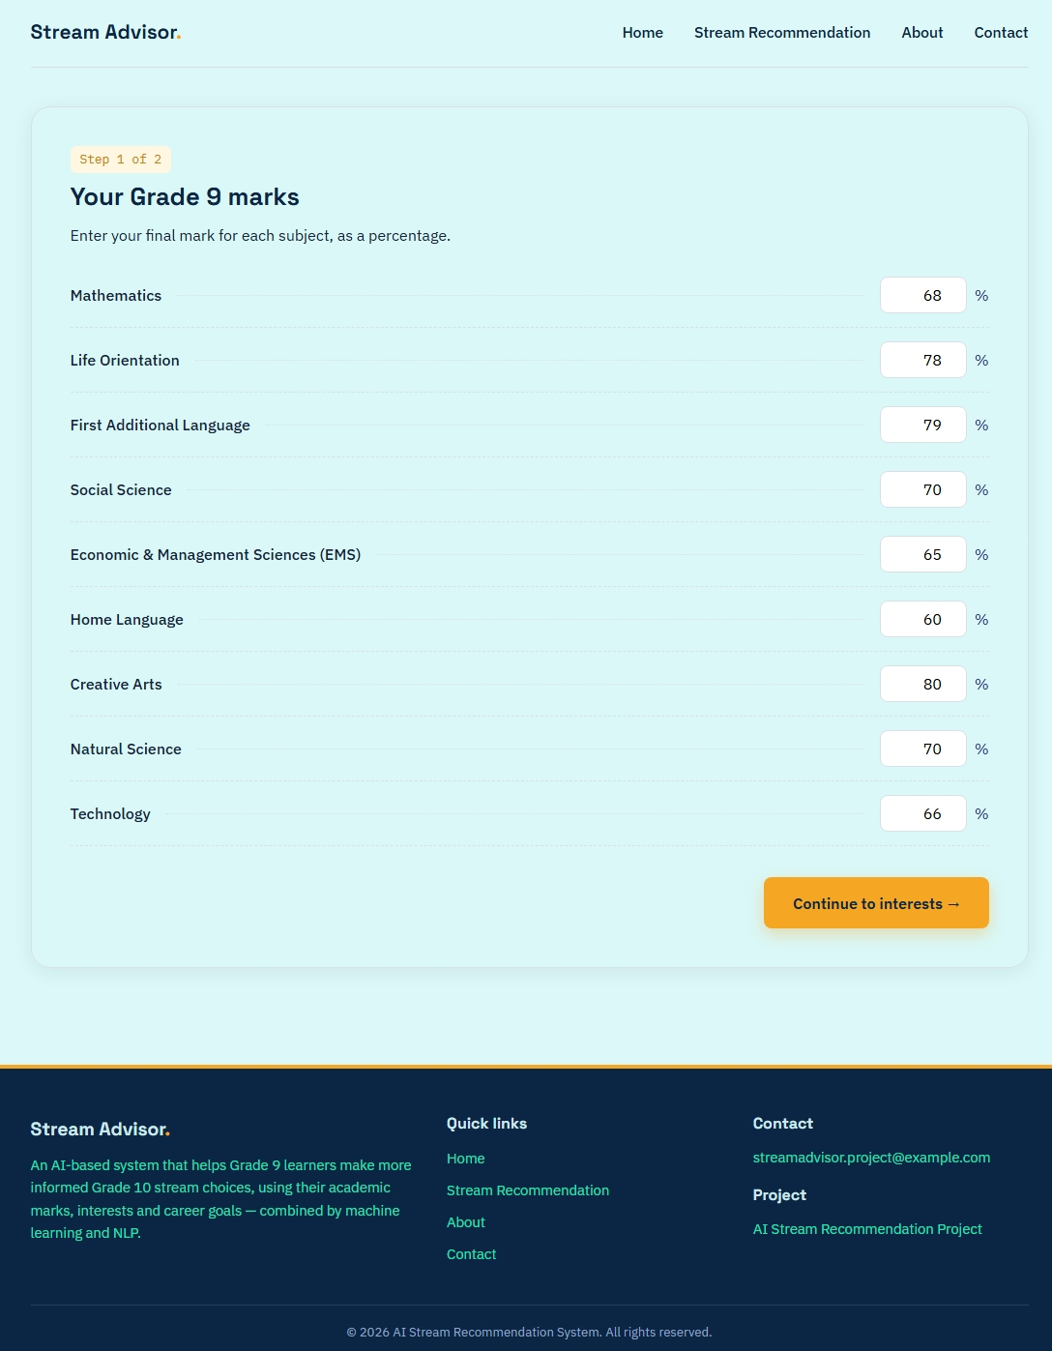
BUSINESS ANALYSIS 3.2 | AIBUY3A
Website Structure and User Journey (ConTINUED…)
ENTERING MARKS

Slide 11
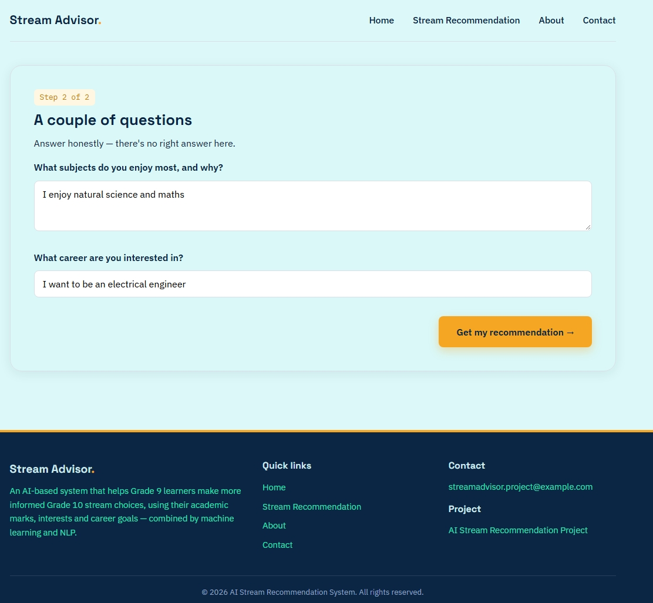
BUSINESS ANALYSIS 3.2 | AIBUY3A
Website Structure and User Journey (ConTINUED…)
CHATBOT

Slide 12
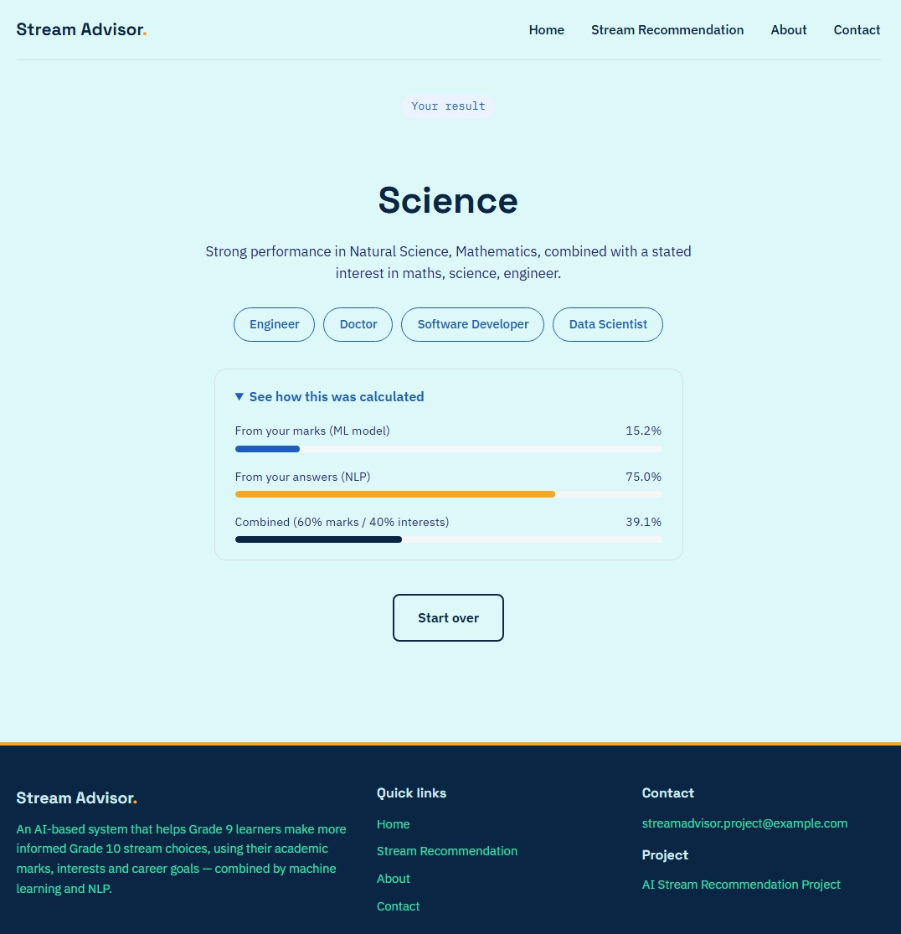
BUSINESS ANALYSIS 3.2 | AIBUY3A
Website Structure and User Journey (ConTINUED…)
STRAM RECOMMENDATION

Slide 13
BUSINESS ANALYSIS 3.2 | AIBUY3A
TOOLS AND TECHNIQUES
TOOLS USED
TECHNIQUES USED
• Python: Main language for recommendation logic, data processing and Flask backend.
• Scikit-learn: Decision Tree, Random Forest, model evaluation and cross-validation.
• Pandas: Reads, inspects and prepares the CSV dataset.
• Joblib: Saves and loads the trained model and label encoder.
• Flask: Web application backend; handles routes and connects interface to recommendations.
• HTML / CSS / JavaScript: Page structure, visual design, layout and client-side interactions.
• Git and GitHub: Version control, collaboration and project evidence.
• Decision Tree – predicts streams from subject marks.
• Random Forest – combines multiple decision trees.
• Natural Language Processing – keyword matching for interests and career goals.
• Data preparation – checks missing values, duplicates, mark ranges and labels.
• Model evaluation – accuracy, precision and recall .
• Functional testing – checks navigation, validation, model loading and recommendations.
AI-BASED LEARNER STREAM RECOMMENDATION SYSTEM

Slide 14
BUSINESS ANALYSIS 3.2 | AIBUY3A
SYSTEM REQUIREMENTS
FUNCTIONAL REQUIREMENTS
NON-FUNCTIONAL REQUIREMENTS
• Display a home page that explaining the application.
• Allow entry of Grade 9 subject marks.
• Collect learners’ interests and career goals.
• Support school selection where available.
• Process marks using the saved machine learning model.
• Analyse written responses using NLP keywords.
• Combine scores and display a suggested stream with an explanation.
• Show related career information and handle invalid input or errors.
• Usability: easy to understand and navigate.
• Performance: process submissions within a reasonable time.
• handle valid input consistently and provide error feedback.
• Security: protect sensitive information and minimise personal data.
• Organise code so components can be updated.
• Test desktop and mobile screen sizes.
AI-BASED LEARNER STREAM RECOMMENDATION SYSTEM

Slide 15

BUSINESS ANALYSIS 3.2 | AIBUY3A
CONCLUSION
In conclusion, our project aims to address the challenges Grade 9 learners face when choosing their Grade 10 subjects.
By combining machine learning and Natural Language Processing, our proposed website will consider both academic performance and personal interests to generate personalised stream recommendations.
We believe that this solution can provide additional guidance and help learners make better-informed decisions about their education and future careers.
Thank you for your time and attention

